Slide 1
Roslyn
Vishal Anand
https://github.com/codingonHP/RoslynTalk (26/11/2016)

Slide 2
Agenda
Compiler : Roslyn
Environment Setup
Key Concepts in Compilation of source code
Brief look at API
Analyzers
Fixers
What cool things people have built ☺

Slide 3
Compiler – Black box
Till now Compiler was a big BLACK BOX
Source Code goes in one end, magic* happens in the middle, and object files or assemblies come out the other end.

Slide 4
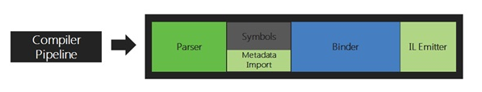
Exposing the Core API: Pipeline

Slide 5
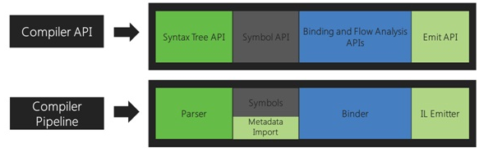
Exposing the core api : Compiler API

Slide 6
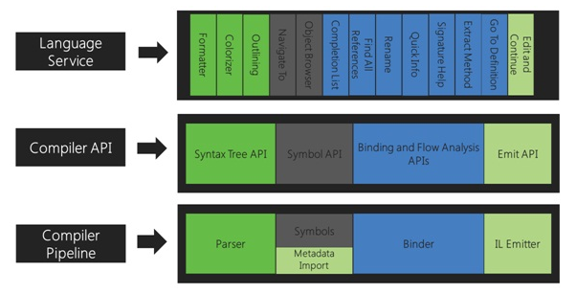
Exposing the core api

Slide 7
ENVIRONMENT SETUP
Roslyn SDK
Visual Studio SDK
Available in Nuget ☺
Visual Studio -> New Project -> Extensibility

Slide 8
KEY CONCEPTS : SYNTAX TREES
The primary structure used for compilation, code analysis, binding, refactoring, IDE features, and code generation.
Full fidelity
Round trippable
Mutable

Slide 9
KEY CONCEPTS : SYNTAX NODES
Represent syntactic constructs such as declarations, statements, clauses, and expressions.
All syntax nodes are non-terminal nodes in the syntax tree
Each category of syntax nodes is represented by a separate class derived from SyntaxNode.

Slide 10
KEY CONCEPTS : SYNTAX TOKENS
Syntax tokens are the terminals of the language grammar, representing the smallest syntactic fragments of the code.
Syntax tokens consist of keywords, identifiers, literals, and punctuation.

Slide 11
KEY CONCEPTS : SYNTAX TRIVIA
Syntax trivia represent the parts of the source text that are largely insignificant for normal understanding of the code, such as whitespace, comments.

Slide 12
KEY CONCEPTS : SPANS
Each node, token, or trivia knows its position within the source text and the number of characters it consists of.
Represented as a 32-bit integer

Slide 13
KEY CONCEPTS : KINDS
Identifies what kind of node, token or trivia is it.
Example : Add Expression, Int, String

Slide 14
KEY CONCEPTS : ERRORS
Even when the source text contains syntax errors, a full syntax tree that is round-trippable to the source is exposed.

Slide 15
DEMO
Syntax Tree
Syntax Tree Analyzer

Slide 16
Semantic analysis
Semantic Model
We can use Semantic model to ask questions such as –
What are the symbols available ?
Get us the Diagnostic information available. (Error , warnings …)

Slide 17
Syntactic vs semantic analysis

Slide 18
Brief API Walkthrough
Syntax Tree related API
CompliationUnitSyntax
CSharpSyntaxTree
SyntaxFactory*
SyntaxKind
SyntaxVisitors
SyntaxWalkers*
SyntaxVisitorRewriter*
--------------------------------------------------------------------------------
Ancestors, Parent, AncestorsAndSelf, ChildNodes, DescendantNodesAndSelf functions similar to jQuery style

Slide 19
Compilation API
Compilation
CSharpCompilation
Used to compile and output the result of compiling code tree

Slide 20
Writing a simple analyzer

Slide 21
Writing a SIMPLE CODE FIXER

Slide 22
Real world examples
https://github.com/oleg-shilo/cs-script
http://comealive.io/
https://github.com/codingonHP/SyntaxTreeVisualizer

Slide 23
References
https://github.com/dotnet/roslyn
https://msdn.microsoft.com/en-us/vstudio/hh500769
https://github.com/dotnet/roslyn/wiki/Roslyn-Overview
https://github.com/dotnet/roslyn-analyzers
https://msdn.microsoft.com/en-us/vstudio/hh500769#Toc306015663
https://github.com/dotnet/roslyn/tree/master/docs
https://github.com/dotnet/roslyn/wiki/Getting-Started-C%23-Syntax-Analysis
https://github.com/dotnet/roslyn/wiki/How-To-Write-a-C%23-Analyzer-and-Code-Fix
https://msdn.microsoft.com/en-us/magazine/dn879356
https://pluralsight.com

Slide 24
Download presentation && code
https://github.com/codingonHP/RoslynTalk

Slide 25
Thanks

